Slide 1
AI: Introduction
Course Code: CSC4226
Course Title: Artificial Intelligence and Expert System
Dept. of Computer Science
Faculty of Science and Technology
Lecturer: | Asma Fariha asma.fariha@aiub.edu

Slide 2
Lecture Outline
What is AI?
The Foundations of AI.
Brief History of AI
The State of the Art.
Course Outline by Topics and Weeks.

Slide 3
Vision & Mission of AIUB
Vision
AMERICAN INTERNATIONAL UNIVERSITY-BANGLADESH (AIUB) envisions promoting professionals and excellent leadership catering to the technological progress and development needs of the country.
Mission
AMERICAN INTERNATIONAL UNIVERSITY-BANGLADESH (AIUB) is committed to provide quality and excellent computer-based academic programs responsive to the emerging challenges of the time. It is dedicated to nurture and produce competent world class professional imbued with strong sense of ethical values ready to face the competitive world of arts, business, science, social science and technology.

Slide 4
Goals of AIUB
Sustain development and progress of the university
Continue to upgrade educational services and facilities responsive of the demands for change and needs of the society
Inculcate professional culture among management, faculty and personnel in the attainment of the institution's vision, mission and goals
Enhance research consciousness in discovering new dimensions for curriculum development and enrichment
Implement meaningful and relevant community outreach programs reflective of the available resources and expertise of the university
Establish strong networking of programs, sharing of resources and expertise with local and international educational institutions and organizations
Accelerate the participation of alumni, students and professionals in the implementation of educational programs and development of projects designed to expand and improve global academic standards

Slide 5
Vision & Mission of Computer Science Department
Vision
Provides leadership in the pursuit of quality and excellent computer education and produce highly skilled and globally competitive IT professionals.
Mission
Committed to educate students to think analytically and communicate effectively; train them to acquire technological, industry and research-oriented accepted skills; keep them abreast of the new trends and progress in the world of information communication technology; and inculcate in them the value of professional ethics.

Slide 6
Goals of Computer Science Department
Enrich the computer education curriculum to suit the needs of the industry- wide standards for both domestic and international markets
Equip the faculty and staff with professional, modern technological and research skills
Upgrade continuously computer hardware's, facilities and instructional materials to cope with the challenges of the information technology age
Initiate and conduct relevant research, software development and outreach services.
Establish linkage with industry and other IT-based organizations/institutions for sharing of resources and expertise, and better job opportunities for students

Slide 7
Course Prerequisite
Representing information in computers, Binary Number Systems, Conversions.
Programming Languages (C/C++/Python)
Using C/C++/Python editors, debugging
Data Storage Concept & Data types in Programming languages,
Variable, Array (single & multidimensional), Pointers, String
Functions, Recursion, Scope of variable & function
Object oriented programming concept
Design and Analysis of Algorithms
Graph: Elementary concept, Memory representation: Adj. MAtrix/List, Graph traversal/Search: BFS, DFS

Slide 8
Course Objectives
Get an overview of artificial intelligence (AI) principles and approaches.
Develop a basic understanding of the building blocks of AI as presented in terms of intelligent agents: Search, Knowledge representation, inference, logic, learning.
Develop a brief overview of AI applications: Expert Systems and Planners.
Follow AI literature with the ability to go on to independent work in the field.

Slide 9
Importance of the course
Studying artificial intelligence opens a world of opportunities.
At a basic level, you’ll better understand the systems and tools that you interact with daily. And if you stick with the subject and study more, you can help create cutting edge AI applications, like the Google Self Driving Car, or IBM’s Watson.
In the field of artificial intelligence, the possibilities are truly endless.
Studying AI now can prepare you for a job as a researching neural networks, human-machine interfaces, and quantum artificial intelligence.
Or you could work as a software engineer in industry working for companies like Amazon to shopping list recommendation engines or Facebook analyzing and processing big data.
You could also work as a hardware engineer developing electronic parking assistants or home assistant robots.

Slide 10
Course Contents
Introduction to Artificial Intelligence
Intelligent Agent
Problem Solving, Search and Control Strategies
Knowledge Representation Issues, Predicate Logic, Rules
Reasoning System: Symbolic, Statistical
Learning Systems
Expert System
Neural Networks: Fundamental
Genetic Algorithms: Fundamental
Natural Language Processing
Common Sense Knowledge
Computer Vison & Image Processing

Slide 11
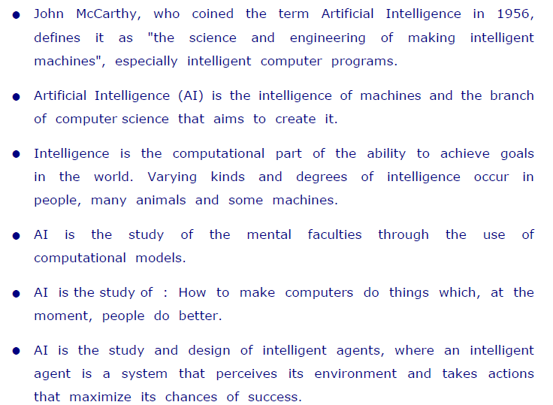




What is Artificial Intelligence ?

Slide 12
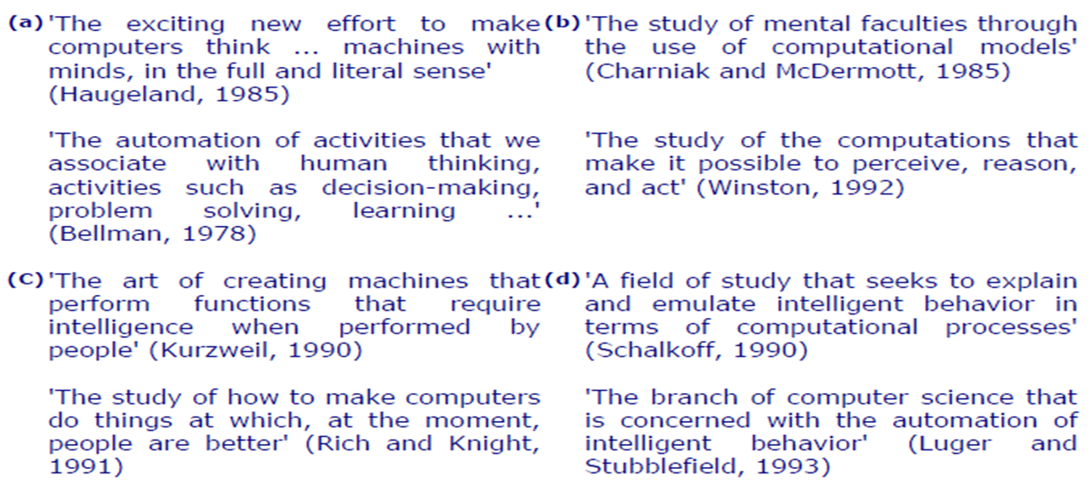
Definition of AI: Outlined in Textbox

Slide 13
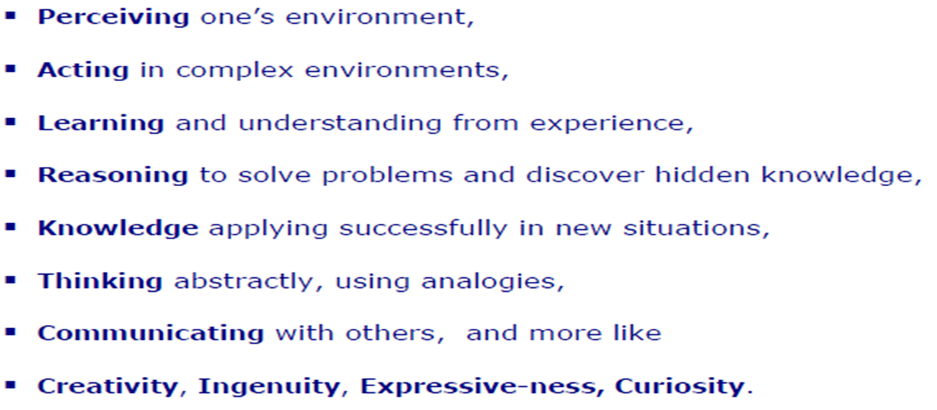






Intelligent Behavior

Slide 14
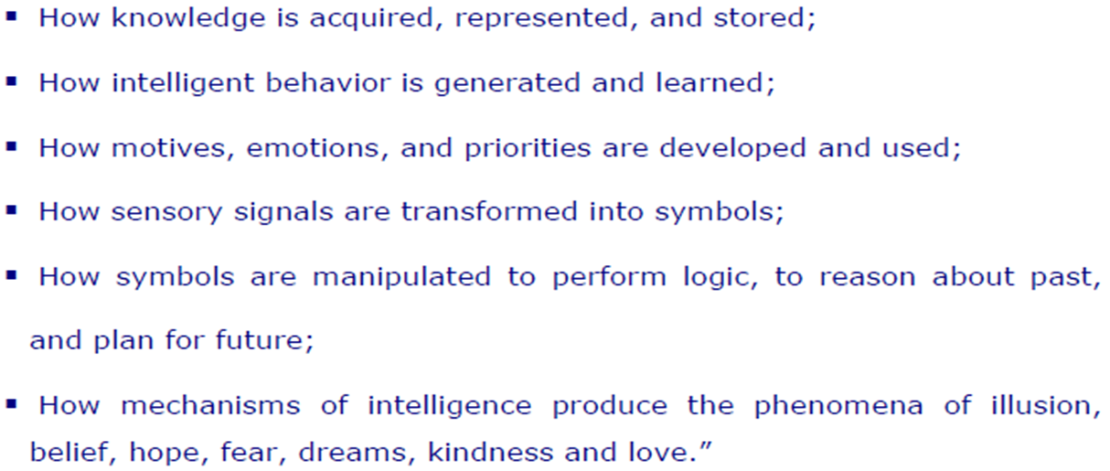
Understanding AI

Slide 15
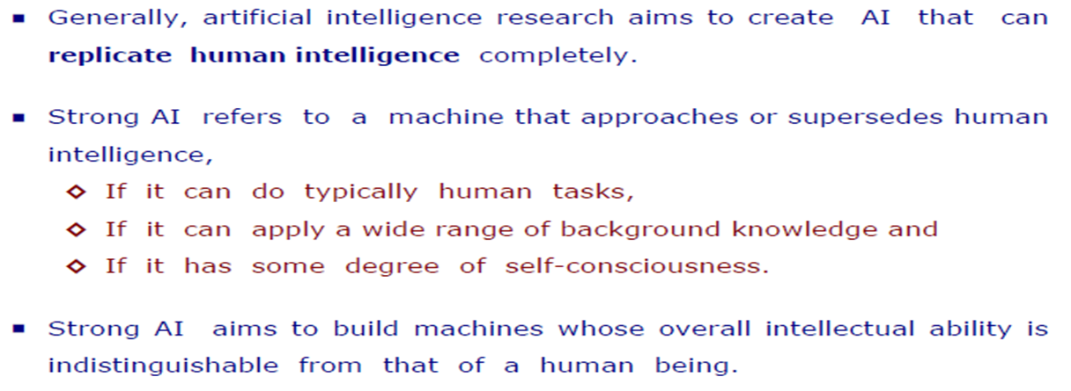
Types of AI
Hard or Strong AI

Slide 16
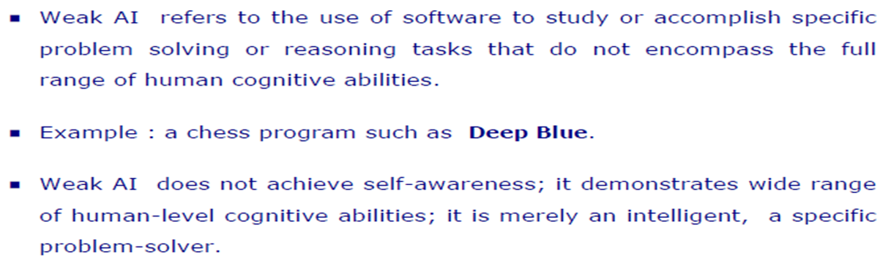



Types of AI
Soft or Weak AI

Slide 17
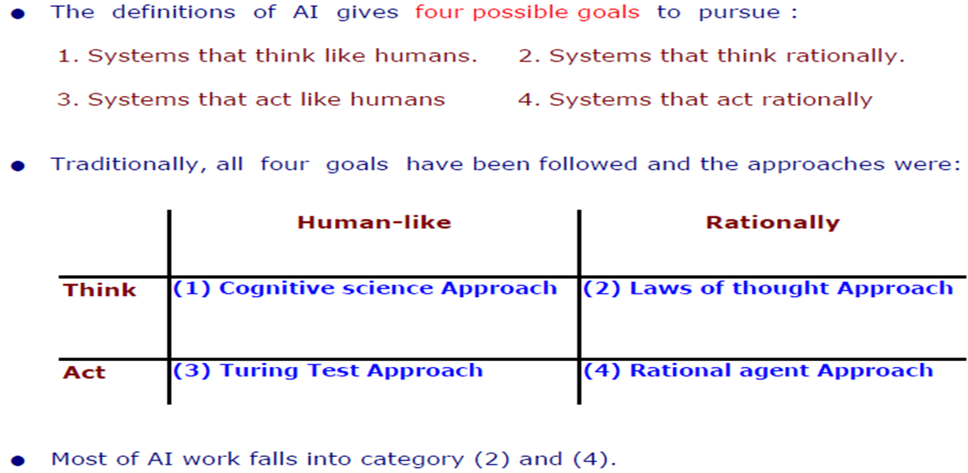
Goals of AI

Slide 18
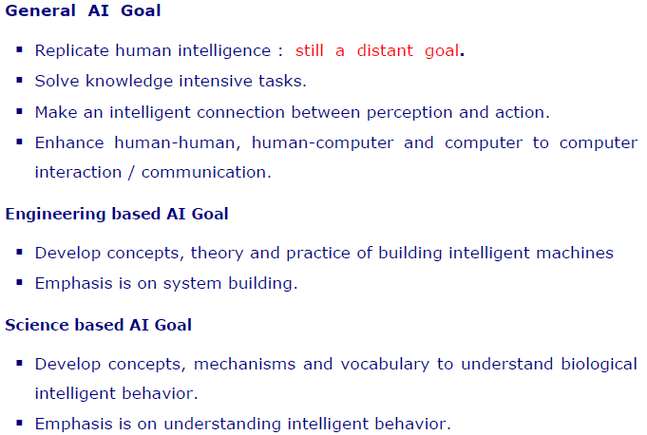


Goal of AI
Continued…

Slide 19
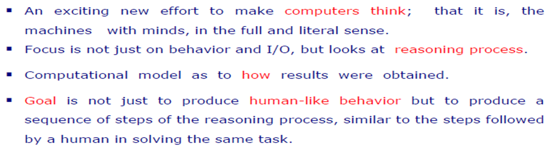

AI Approaches
Cognitive Science : Think Humanly

Slide 20
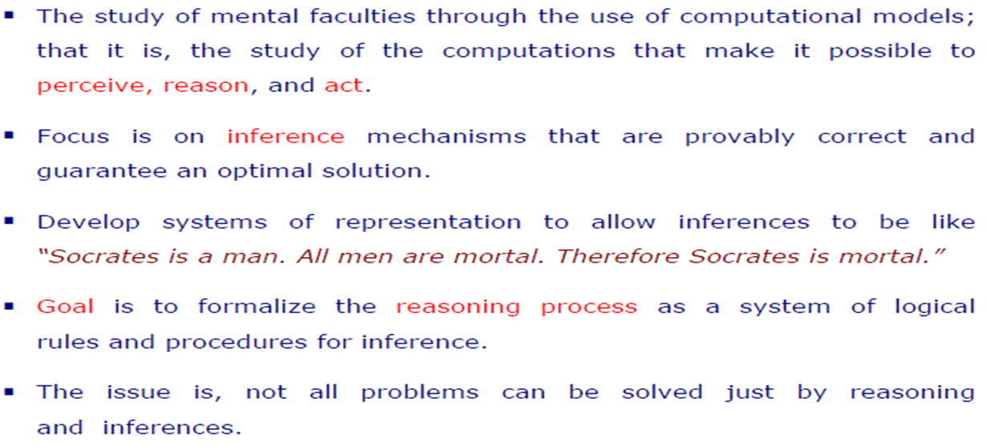














AI Approaches
Laws of Thought: Think Rationally

Slide 21
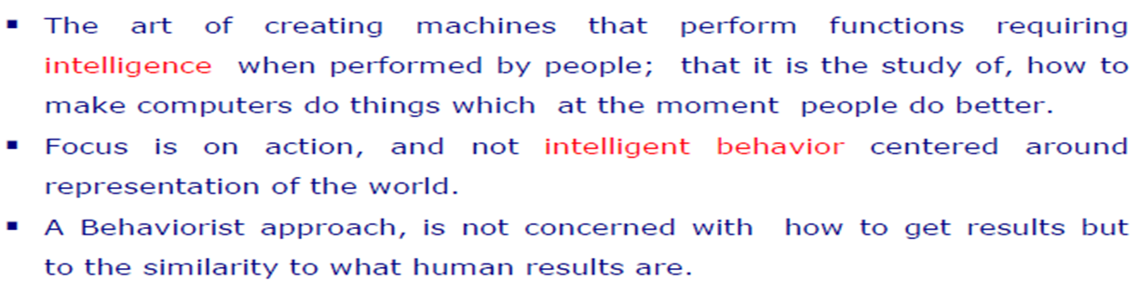

AI Approaches
Turing Test: Act Humanly

Slide 22
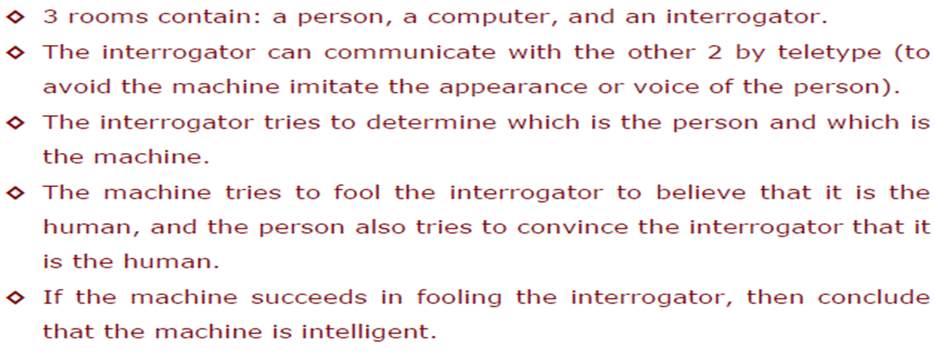
AI Approaches
Turing Test

Slide 23
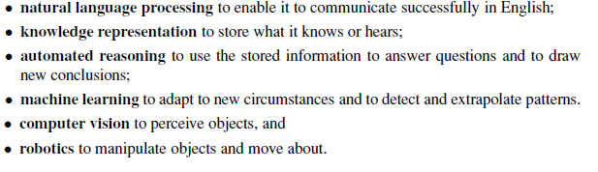
AI Approaches
Turing Test : Capabilities Required to Pass Complete Turing Test

Slide 24
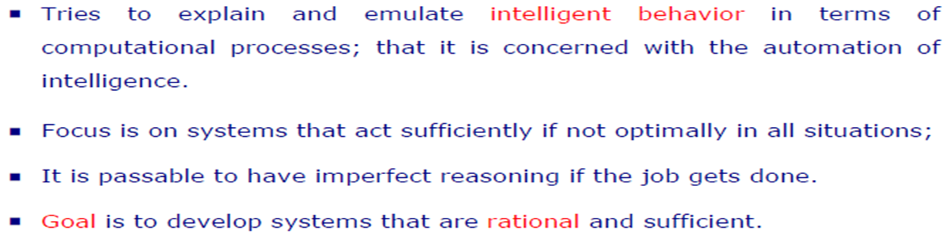
AI Approaches
Rational Agent: Act Rationally

Slide 25
References
Chapter 1: Introduction , Pages 1-29
“Artificial Intelligence: A Modern Approach,” by Stuart J. Russell and Peter Norvig,
2. Intro to Artificial Intelligence and Expert System - Dan W. Patterson
3. Neural Networks, Fuzzy logic and Genetic Algorithms – S. Rajasekaran, G.A. Vijayalakshmi Pai

Slide 26
Books
“Artificial Intelligence: A Modern Approach,” by Stuart J. Russell and Peter Norvig.
"Artificial Intelligence: Structures and Strategies for Complex Problem Solving", by George F. Luger, (2002)
"Artificial Intelligence: Theory and Practice", by Thomas Dean.
"AI: A New Synthesis", by Nils J. Nilsson.
“Programming for machine learning,” by J. Ross Quinlan,
“Neural Computing Theory and Practice,” by Philip D. Wasserman, .
“Neural Network Design,” by Martin T. Hagan, Howard B. Demuth, Mark H. Beale, .
“Practical Genetic Algorithms,” by Randy L. Haupt and Sue Ellen Haupt.
“Genetic Algorithms in Search, optimization and Machine learning,” by David E. Goldberg.
"Computational Intelligence: A Logical Approach", by David Poole, Alan Mackworth, and Randy Goebel.
“Introduction to Turbo Prolog”, by Carl Townsend.

